Slide 1

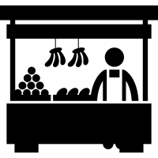
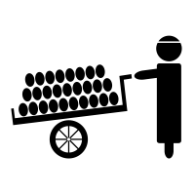

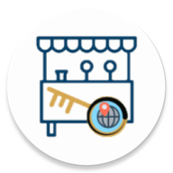

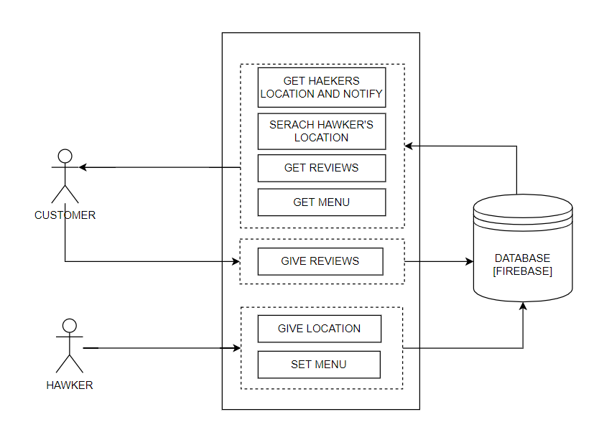
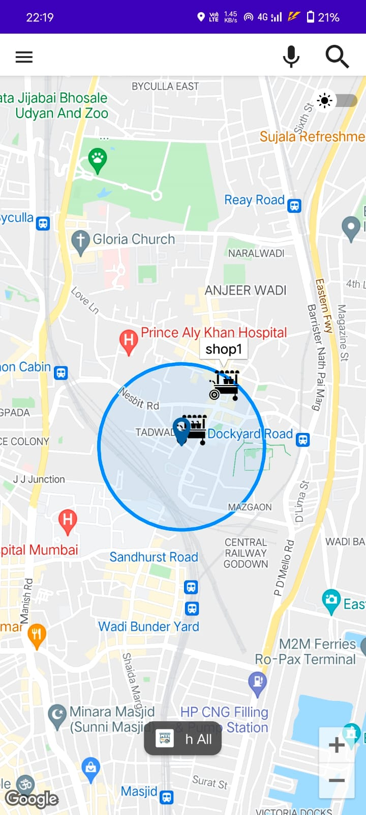
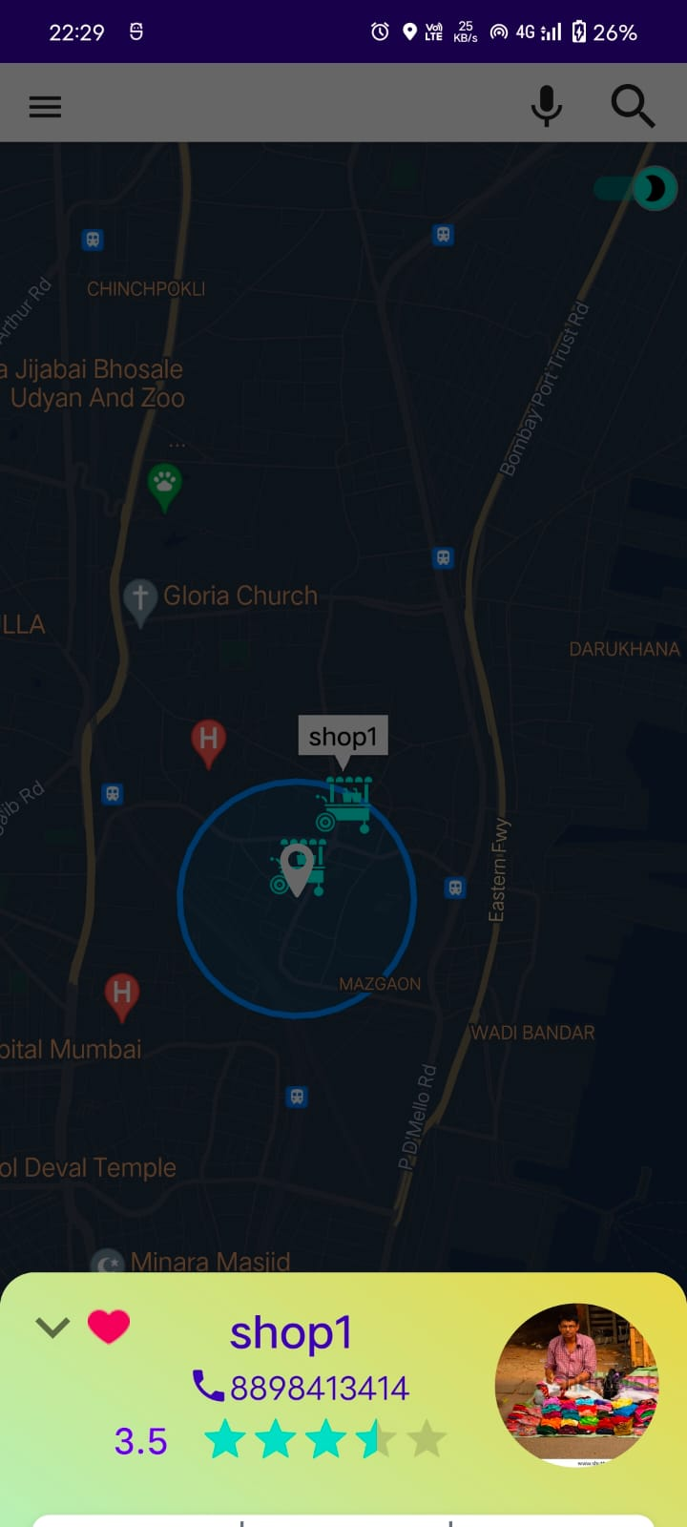
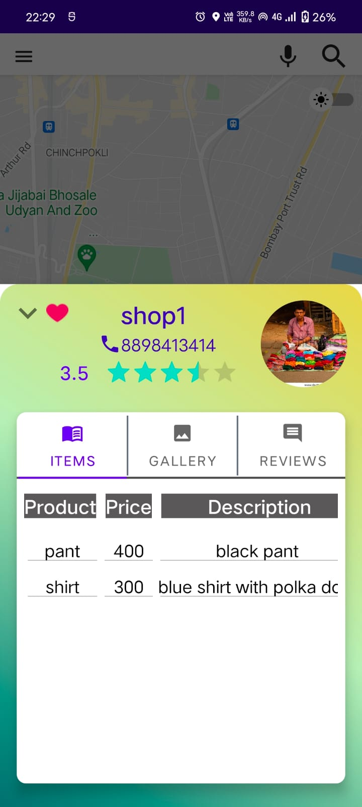

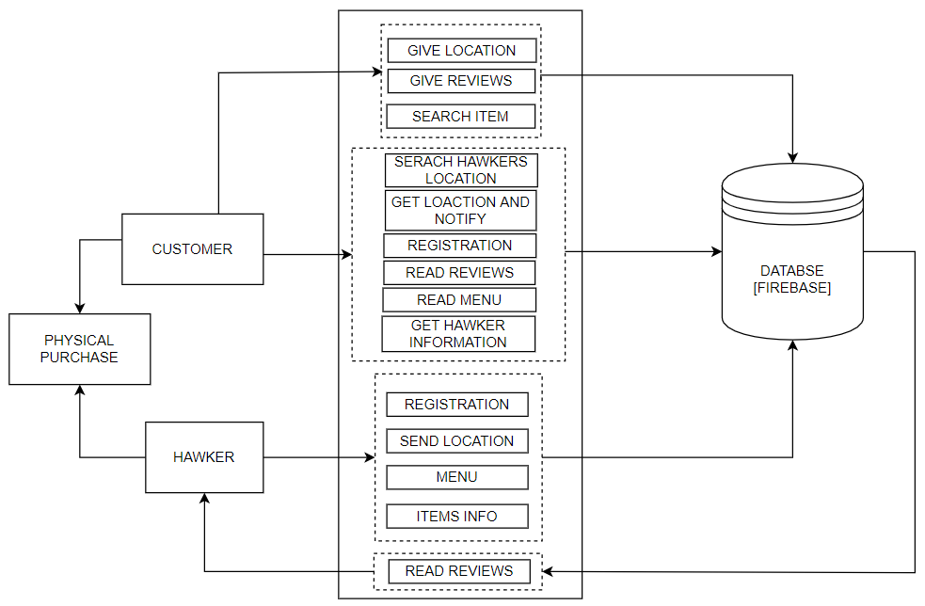
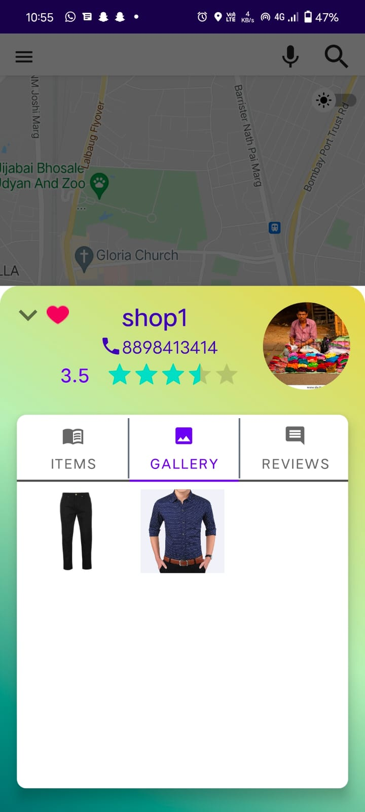
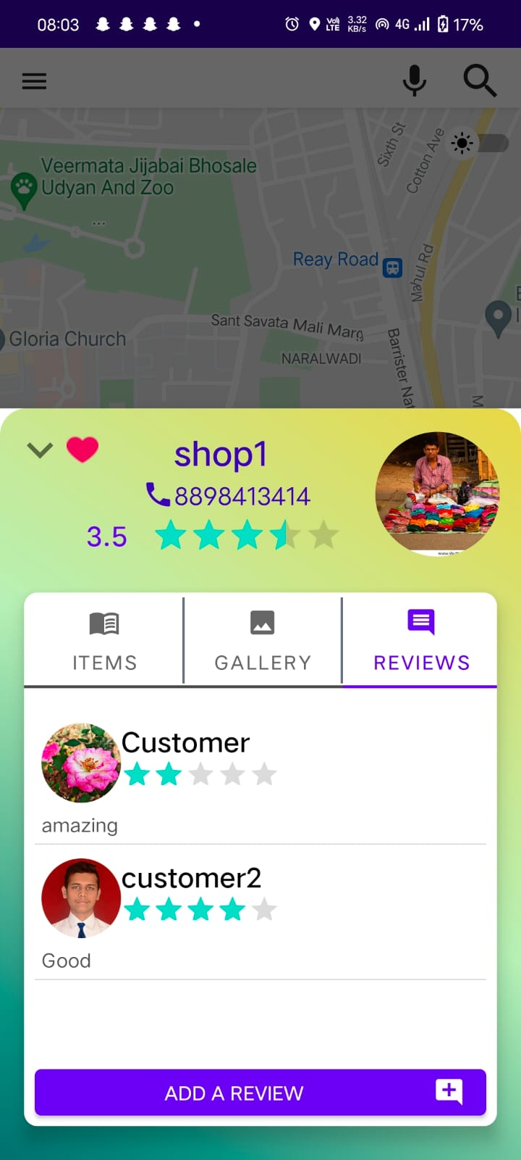
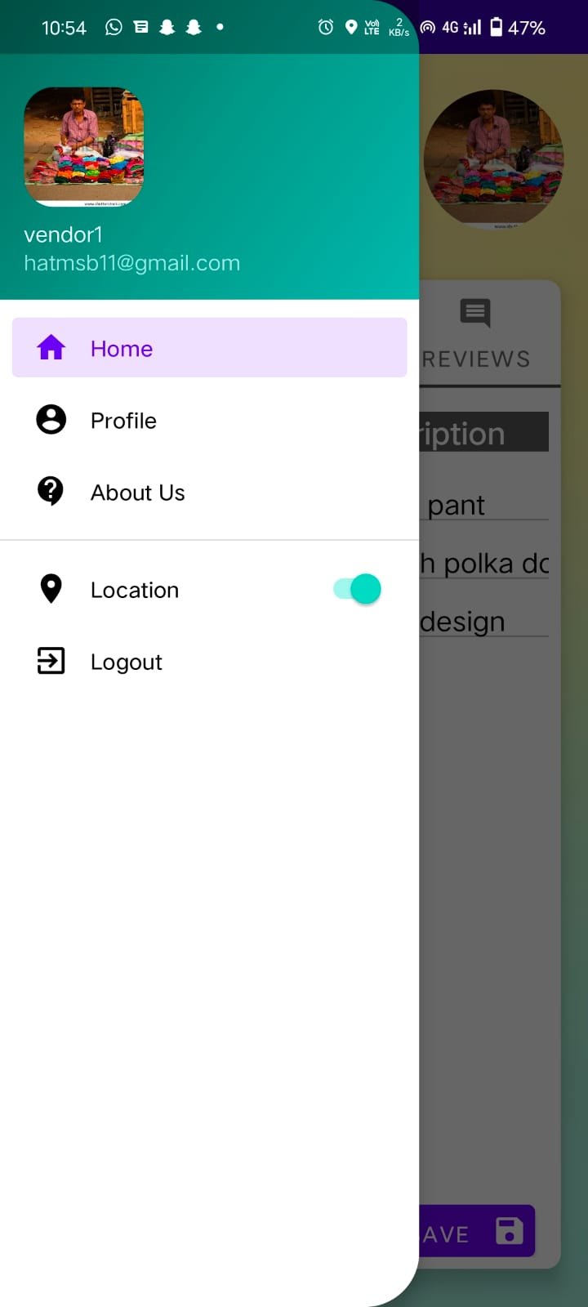
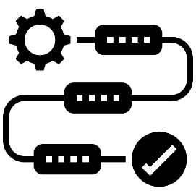

VendorLink: Connecting Customers to Street Vendors (ANDROID APPLICATION)
ABSTRACT
Street vendors as part of the informal workforce offers easy access to fresh vegetables and fruits at a lower price on a daily basis. While the market has evolved and demand has grown over time, the informal sector workers have found difficult to catch up with the modern retail and disruptive technologies that have come in. Besides offering products at lower cost, street vendors hold an advantage of providing much fresher produce than these suppliers. However, there are challenges for consumers in accessing street vendors across various locations. Bringing street vendors on a digital platform could integrate them into the digital space, and thereby help in improving their market reach, service delivery and the overall system performance by making it efficient.
RESULTS
BLOCK DIAGRAM (VENDORLINK APPLICATION)
INTRODUCTION
According to a survey conducted by Ministry of Housing and Urban Poverty Alleviation there are around 10 million (i.e. 1cr) hawker in India which are engaged in some or other form of informal vending. These 10 million hawkers constitute around 52% of India's informal economy. When we see around, there are so many digital aggregator platforms for various purposes such as Swiggy & Zomato for restaurants-customers, Netmeds & Pharmeasy for Medicals-customers, BookMyShow for theatres-customers, and the list will go on & on... BUT, even though street vendors form such a large chunk of India's Informal economy (52%), there isn't a single digital platform on which the Street vendors can enlist themselves and prospective customers can search for.
The application ‘VendorLink’ aims to act as an aggregator platform between street vendors i.e. hawker or simply the thelawala's and their prospective customers and improve the overall buying & selling process by providing various features such as Location Tracking, Favourite listing hawkers, Ratings & Reviews, etc.
SYSTEM ARCHITECTURE (VENDORLINK APPLICATION)
PROPOSED METHODOLOGY
For a customer to buy products from a particular vendor/hawker, he/she need to know the exact time and location of hawkers which is a pretty daunting task. VendorLink Application solves this problem.
The proposed application is free and easy to use for both the customers and vendor/hawker.
The customer can search for a particular hawker and get to know his/her current location.
The vendor/hawker can create their profiles easily by just getting basic KYC done. The customer can even rate and review about a particular vendor/hawker.
OBJECTIVE
To study the existing business model for vendors & hawkers.
To understand problems faced by hawkers/vendors and propose a system.
To create a module for registration of hawkers/vendors in the application.
To develop a Location tracking module in the application.
To develop a Feedback/Review system for customers in the application.

